Slide 1


Digitalization and Behavioral Consequences during the Coronavirus Lockdowns
Marina Ryzhkova,
Prof. in Economics (Dr. Habil.),
Economics Department
Institute of Economics and Management,
Tomsk State University (Russia).
The 1st International Winter School in Political Economy
11 February 2020

Slide 2
Plan
Some preliminary notes
Consequences
Short-terms consequences
Long-term consequences

Slide 3
Some preliminary notes (1)
Topic: Digitalization and Behavioral Consequences during the Coronavirus Lockdowns
FROM – Digitalization – the process of converting information into a digital (i.e. computer-readable) format (Wiki)
TO – Digital Transformation (DT or DX) – the adoption of digital technology to transform services or businesses, through replacing non-digital or manual processes with digital processes or replacing older digital technology with newer digital technology (Wiki).

Slide 4
Some preliminary notes (2)
Topic: Digitalization and Behavioral Consequences during the Coronavirus Lockdowns
Behavioral Consequences:
- Individuals
- Habit transformation, new practices
- Environment change influence
Short-term and Long-term Consequences – will be discussed later on.

Slide 5
Some preliminary notes (3)
Digitalization and Behavioral Consequences during the Coronavirus Lockdowns
Coronavirus Lockdowns –
No coordination even within one country (ex. USA, Brazil – some territories without lockdown)
Without lockdown – Sweden, Taiwan, Japan, Belarus and 13 other countries
Step-by-step improvement of epidemic regulations
No common system of alert exists

Slide 6
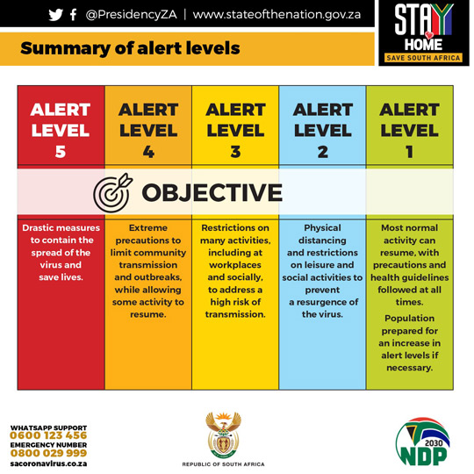
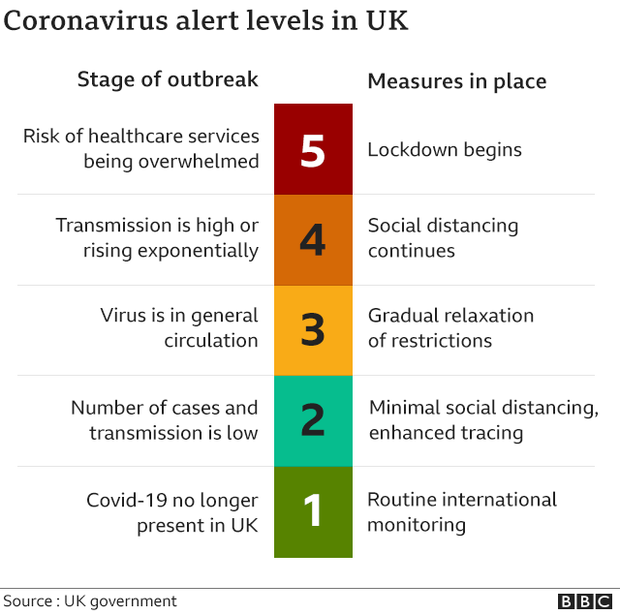
Examples of alert systems
Introduced in March 26, 2020
Introduced in May 10, 2020

Slide 7
In Russia
Began in March 2020
- Panic and gossip
- Refuse to believe
- Do not take seriously
Regulatory improvement during 2 waves
Example:
Procedure for preventing the threat of emergencies due to the spread of dangerous infectious diseases – Regulatory act, January 10, 2021.
3 risk levels:
Infection is on territory of other countries
Isolated cases on the territory of Russia
Epidemic in one or several regions of Russia

Slide 8
Some preliminary notes (4)
Digitalization and Behavioral Consequences during the Coronavirus Lockdowns
Coronavirus Lockdowns –
WHO’s country and technical guidance on COVID-19
1-metre distance
wearing a mask
avoid crowded spaces
washing hands

Slide 9
Consequences
Short-terms consequences
Research of consequences of COVID-19
Students from Russia and some Int students
March 2020
Long-term consequences
Brainstorming
Expert pool
May 2020

Slide 10
Short-terms consequences
The consequences of coronavirus for the economy and society. 5 Open questions.
1) SHORT-TERM economic impact
2) SHORT-TERM social and other consequences
3) LONG-TERM economic consequences
4) LONG-TERM social and other consequences
5) In what areas and what new ways of digitalization have appeared.

Slide 11
Method
April 8-12, 2020
7 Russians and 8 International students
Open questions in Google Form
https://docs.google.com/forms/d/1DuBcZJujHul8J9OUxks6UBCEoigiwzPXwbOMmt3HdOE/edit
Ranking in Google Sheets by participants.
Final rating (aggregating)

Slide 12
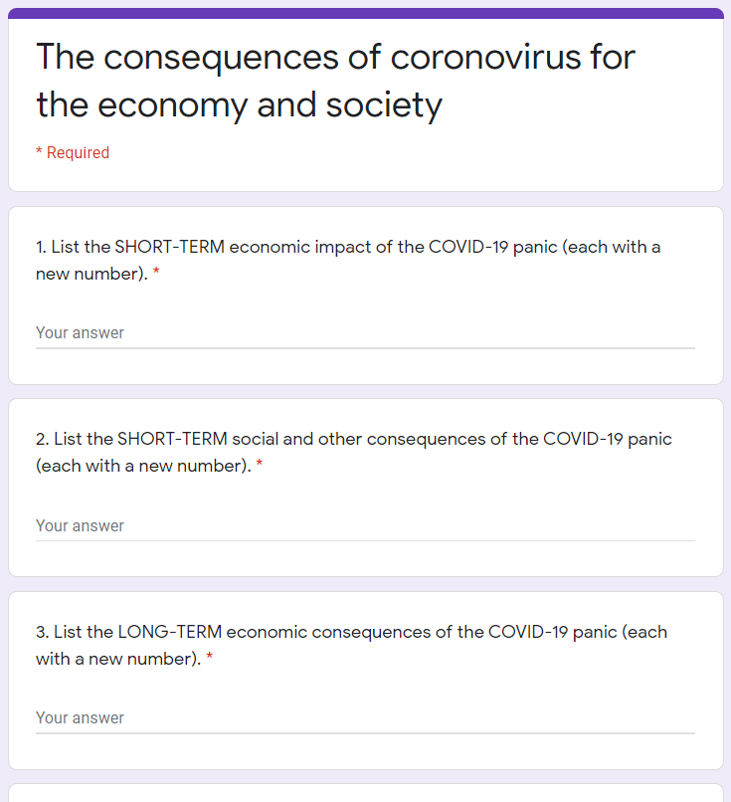

Slide 13
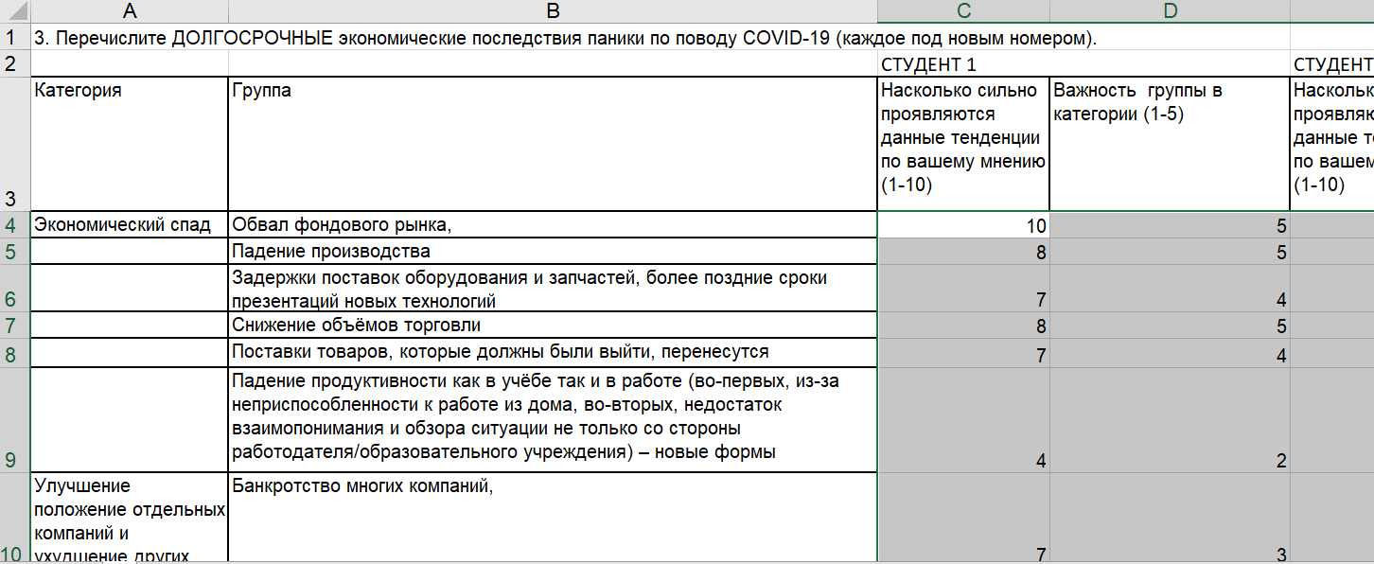
Ranking

Slide 14
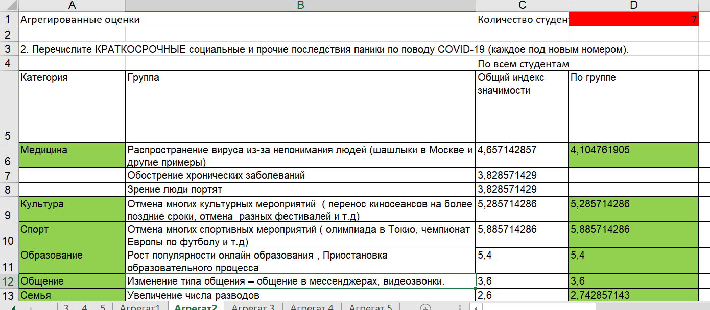
Aggregating

Slide 15
Interesting findings towards digitalization students, April 2020
TREND | Was | Continue
Growth in demand for entertainment / educational Internet resources, growth in demand for products through online stores | YES | YES
Increased demand for delivery services | YES | YES
Load on Internet providers and deterioration of communication quality | NO | NO
The rise in popularity of online education | YES | Return in offline
Changing the type of communication - chatting in messengers, video calls. | YES | YES
Transition of offices, schools, universities to remote interaction in the long run | YES | NO
Improving computer skills among citizens | YES | YES
Digital services become more popular | YES | YES

Slide 16
Long-terms consequences
The impact of digital technologies on consumer behavior.
The phenomenon of “Resistance of Digitalization”
3-round Delphi
Google Form questionnaire

Slide 17
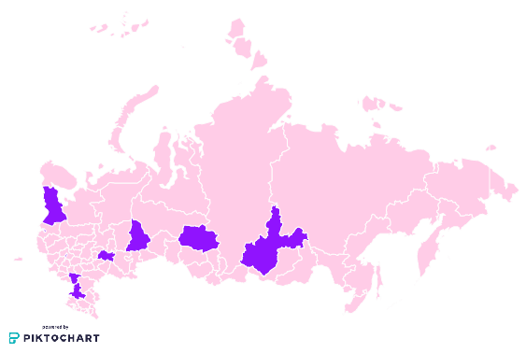
Russian experts
27 experts
Moscow, St. Petersburg, Yekaterinburg, Voronezh, Kazan, Rostov-on-Don, Petrozavodsk, Tomsk, Irkutsk and Ulan-Ude
Academics
Economists, engineers, sociologists, philosophers, doctors, programmers, experts in the field of economic policy and economic security problems

Slide 18
Brainstorming by rounds
Round 1
Formulation of potential threats for each technology from the prepared list
Round 2
Formulation of possible reactions of end users to threats
Round 3
Formulation of possible actions of stakeholders (firms and the state) in response to consumer reactions
Consolidation of threats
Pool of consumer reactions
Stakeholder actions grouping

Slide 19
Interesting findings towards digitalization experts, May 2020 (1)
1 round. Threats of digitalization
The threat of unintentional harm to human health is seen as the least dangerous.
The most dangerous threats are those that are outside the consumer's locus of control.
An individual can resist manipulation of consumer choice more successfully than prevent the actions of intruders.
The risk of changes in social interactions, loss of communication skills with real people, and self-isolation in the digital space is also a serious concern.

Slide 20
Interesting findings towards digitalization experts, May 2020 (2)
2 round. Possible reactions of end users to threats of digitalization
A complete rejection of contacts with digital innovations is hardly possible.
Resistance to digitalization will take such forms as
- passive postponing of digital technologies using or
- «digital parasitism» when there are intermediaries between an individual and technology (relatives, friends, specialists).
The most effective way to neutralize threats is through the development of digital skills

Slide 21
Interesting findings towards digitalization experts, May 2020 (3)
3 round. Stakeholder actions
3 types of actions: administrative, nudge and cognitive
The best option is when the government and firms combine their efforts in all three groups of methods.
Also, the government should not lay upon only administrative methods and act more in a gentle way.

Slide 22


Sincere gratitude to my colleagues
Ekaterina Soboleva Tyjana Zambalaeva

Slide 23


Thank you for your attention
Marina Ryzhkova
Prof. in Economics (Dr. Habil.),
Economics Department
Institute of Economics and Management,
Tomsk State University (Russia).
marybox@inbox.ru
TSU – personal page

