Slide 1
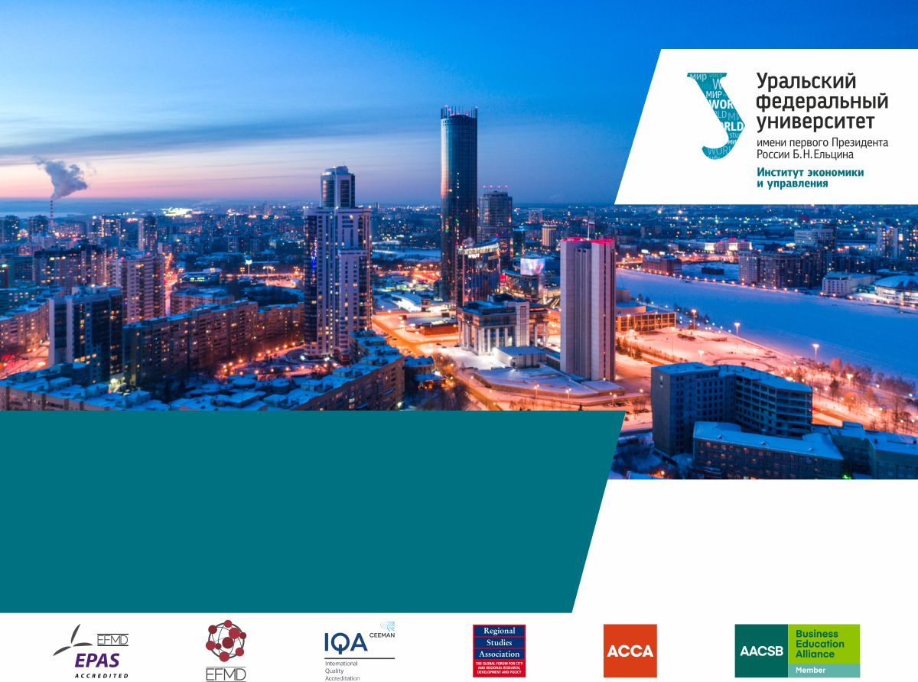
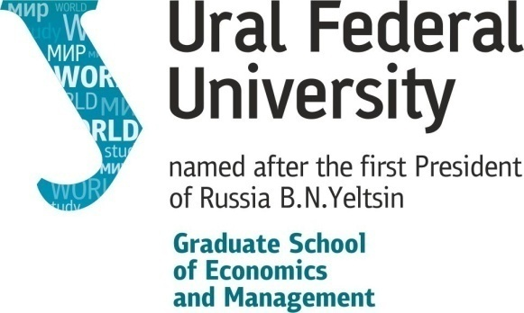
The Spatial and Social Impacts of Economic Sanctions During the Coronavirus Pandemia

Slide 2
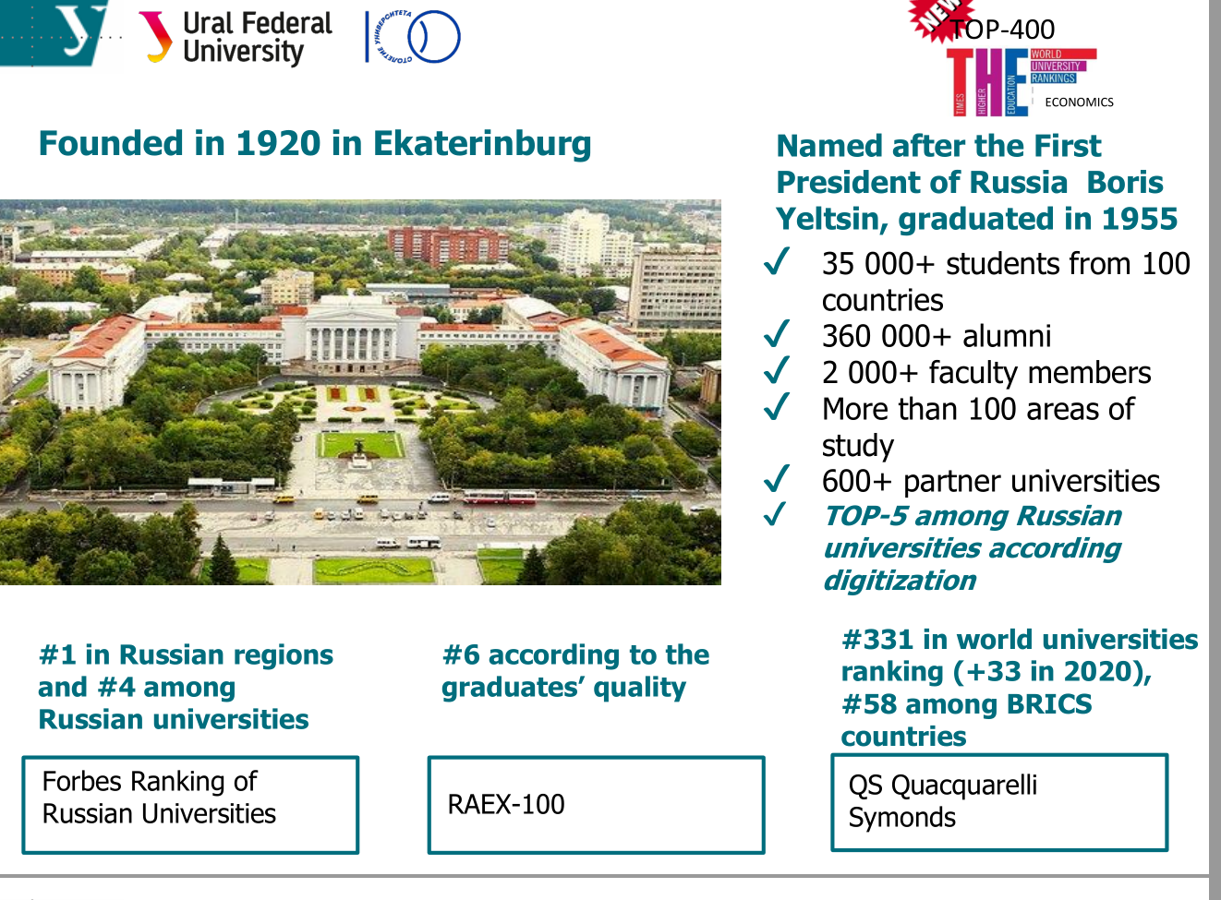

Slide 3
PLAN
Sanctions: definition, types
Some theoretical aspects
Sanctions against the Russian Federation
Sanctions initiated by the Russian Federation
Sanctions and coronavirus

Slide 4
INTERNATIONAL SANCTIONS: NARROW DEFINITION
UN sanctions are understood as a system of non-military, mostly economic coercive measures, imposed by the UN Security Council on the basis of Article 41 of the UN Charter, against the state offending international peace and security.
The purpose of UN sanctions is to stop such an offense and to ensure that the offending state fulfils the obligations that arise from the legal relationship of responsibility.

Slide 5
APPLICATION PRACTICE
Sanctions are increasingly being applied by sovereign states rather than by international organisations.
As of April 2014, the UN Security Council had 19 sanctions programmes in place: against Angola, Afghanistan, Haiti, the Congo Republic, Iraq, Iran, North Korea, Cote d'Ivoire, Liberia, Lebanon, Libya, Rwanda, Somalia, Sudan, Sierra Leone, Eritrea and Ethiopia, the former Yugoslavia (including Kosovo), South Africa and Southern Rhodesia
On the part of the UK, unilateral sanctions are currently being applied against more than 40 countries.
In terms of globalisation and reducing the role of the UN, international sanctions are a foreign policy instrument aimed at protecting political and economic interests of sovereign states.

Slide 6
INTERNATIONAL SANCTIONS: BROAD DEFINITION
a set of unilateral or collective measures of a political, economic or legal nature against a sovereign state, its institutions, national companies or individual citizens, with the aim of coercing, restricting, restraining or preventing their activities. In other words, sanctions include measures of non-military and non-force coercion.

Slide 7
CLASSIFICATION OF SANCTIONS by their purpose and nature
Political
Economic
diplomatic (visa bans or withdrawal of diplomatic personnel);
sport (ban on participation in sports events, cancellation of sports events or termination of cooperation);
cultural (termination of scientific, technical and cultural cooperation, cancellation of events);
sanctions on individuals (ban on entry into the country or limited access for individual citizens).
commercial (trade embargo, prohibition or restriction of access to markets, financial resources and infrastructure);
technological (prohibition or restriction of access to technologies and resources, termination of maintenance, etc.);
financial (asset freezes, blocking individuals and organisations from accessing bank accounts held in the UN, restricting access to financial markets, etc.).

Slide 8
SANCTIONS: TRADITIONAL MODEL until mid-1990s
The effectiveness of the sanctions is based on the principle of “pain - gain”.
The probability of policy shift to be made by the target state directly depends on the damage inflicted on its economy.
A necessary condition for obtaining the expected reaction of the target country is the deprivation of its resource base (for example, export revenues, sources of GDP growth) which is essential for its foreign or domestic policy.

Slide 9
THE DOCTRINE OF TARGETED SANCTIONS (SMART SANCTIONS) in the mid-1990s
The "pain - gain“ principle is often ineffective in relation to countries with national consensus on the need to continue the chosen course policy [Askari et al., 2003; Pape, 1997].
In the light of these problems, the doctrine of targeted, or "smart" sanctions was developed, aimed at damaging not the economy of the country as a whole, but the interests of a country's political and economic elites [Cortright, Lopez, 2002; Eyler, 2007; Drezner, 2011].
1) the focus of sanctions on harming the interests of representatives of elite groups, on which the shift in policy of the target country really depends (bans on travel and financial transactions, asset freezes, etc.);
2) limiting (curtailing, banning) military-technical cooperation, the supply of dual-use technologies, equipment and weapons, as well as joint R&D projects in relevant areas;
3) humanitarian exemptions from the sanctions regime to ensure access of the civilian population to external sources of food, medicine, medical care, etc.

Slide 10
SMART SANCTIONS: IMPACT ON INTERNATIONAL POLITICS
1. Reducing the reputational costs of the active use of sanctions tools in foreign policy for the countries imposing sanctions.
2. Growing incentives to use sanctions without a UN Security Council decision or in the "UN+" format, when the country imposing the sanctions relies on the basic UN Security Council decision and supplements it with its own deployed sanctions package, referring to the fact that the corresponding measures are not directed against the target country and its civilian population, but against its elites.
3. Complicating the creation of control mechanisms: economic entities of countries with active economic ties with the target country can seek formats for continuing cooperation, regardless of the sanctions regime. Sanctions tool is the threat to use penalties by national governments against "violators".

Slide 11
SANCTIONS AGAINST THE RUSSIAN FEDERATION: BEGINNING
Initiated by the USA
1991 – ban on the supply to Russia of electronic systems, optical fibres, communications equipment, marine and aeronautical equipment, jet engines, etc.
1998 – the United States added 10 Russian scientific institutions to the "blacklist" (on suspicion of cooperation with Iran in the missile and nuclear fields): American companies were prohibited from receiving any goods, technologies or services directly or indirectly from these Russian organisations.
2012 – the "Magnitsky Act" was adopted, named after a lawyer who was a witness and a suspect in major economic criminal cases against the Hermitage Capital Management Fund. S. Magnitsky died in the Matrosskaya Tishina prison under unclear circumstances, which became the basis for the anti-Russian campaign in the United States and the imposition of sanctions against a number of Russian officials involved (according to the United States) in his death.

Slide 12
RATIO OF THE GDP OF THE COUNTRIES IMPOSING SANCTIONS AGAINST RUSSIA TO THE GDP OF RUSSIA IN 2010 AND 2013 IN TERMS OF 2005 PRICES, TIMES
Country | Ratio |  | Country | Ratio
 | 2010 | 2013 |  | 2010 | 2013
USA | 15.0 | 14.5 | France | 2.5 | 2.4
Japan | 5.1 | 4.8 | Italy | 2.0 | 1.8
Canada | 1.4 | 1.3 | Spain | 1.3 | 1.2
EU countries | 16.4 | 15.3 | Other initiators | 2.1 | 2.0
Incl. |  |  | All initiators | 40.0 | 37.9
Germany | 3.3 | 3.2
Great Britain | 3.0 | 2.8
Source: World Bank

Slide 13
SANCTIONS AGAINST THE RUSSIAN FEDERATION: ESCALATION
Stage 1. Targeted sanctions (March 17 – July 15, 2014). Exclusively against particular individuals and legal entities whose actions are believed to threaten the territorial integrity and political stability of Ukraine directly during and in the first months after the annexation of Crimea and Sevastopol to the Russian Federation.
Stage 2. Sectoral sanctions (July 16 – September 11, 2014). The reason is the aggravation of the armed confrontation in Eastern Ukraine and the allegations of Russia of supporting the unrecognised Donetsk and Lugansk Republics. As a result, entire sectors of the Russian economy (fuel and energy, financial, military-industrial) were damaged, regardless of whether companies in the relevant sectors were involved in the crisis in Ukraine or not.
Stage 3. Escalation of sanctions (September 12, 2014 – August 1, 2017). The lack of progress in the implementation of the Minsk agreements was used as a basis for the prolongation of decisions regarding the application of the sanctions regime The most significant expansion was undertaken by the United States in September 2016, when more than a hundred Russian companies were added to the sanction lists.
Stage 4. Expansion of the grounds for sanctions (August 2, 2017 – August 1, 2019). Strengthening of the sanctions regime was linked with issues that are not related to the problem of the territorial integrity of Ukraine. For example,. August 2018 – violation of the Convention on the Prohibition of the Development, Production, Stockpiling and Use of Chemical Weapons and on their Destruction (CWC) in connection with the Skripals case.
Stage 5. Expansion of institutions involved in sanctions (August 2, 2019 -). Obstruction of providing Russia with any loans, financial or technical assistance from international institutions (IMF, World Bank). American banks are prohibited from participating in the primary sale of Russian non-ruble sovereign debt and from providing non-ruble loans to the Russian government. Applies to ministries, agencies and the “sovereign wealth fund”, including the Central Bank of Russia and the National Welfare Fund.

Slide 14
ECONOMIC SANCTIONS AGAINST RUSSIA
Economic Sector | List of Sanctions
Oil | Sanctions against individual companies and their subsidiaries, as well as related enterprises in other sectors Ban on export of oil production and oil refining technologies to Russia Freezing current projects and refusing to launch new projects
Gas | Sanctions against individual companies and their subsidiaries, as well as related enterprises in other sectors Freezing current projects and refusing to launch new projects
Finance and banking | Freezes of financial assets of Russian legal entities and individuals Disconnecting Russian banking structures from international payment systems Restriction on placing funds in Western banks Restriction of access to credit funds Restriction of opportunities to carry out activities
Military industrial complex | Ban on arms export-import operations with Russia Ban on export of dual-use goods and technologies to Russia
Other | Sanctions against companies and individuals of the Russian Federation Ban on investment projects, supply of equipment and materials for infrastructure, transport, energy of Crimea and Sevastopol

Slide 15
EFFECTS OF ECONOMIC SANCTIONS ON RUSSIA AND WESTERN ECONOMIES
Sanctions against Russia | Effects
 | Russia | Western countries
Restriction of access to credit resources | Banking system crisis, reduced investment potential, loss of liquidity | Decrease in the level of profitability of the banking system. Expansion of the ruble payment area
Ban on selling oil and gas production equipment | Insignificant decrease in oil and gas production | Increase in purchasing prices for oil and gas from Russia
Ban on export and import of technology | Expansion of technology export to the countries of East, Africa and South America. Improving the technological capabilities of domestic production | High risk of significant economic losses

Slide 16
SANCTIONS INITIATED BY THE RUSSIAN FEDERATION
Regulation: Federal Law On Special Economic Measures (No. 281 of 30.12.2006). Sanctions can be imposed with the aim of ensuring the security and interests of the Russian Federation, as well as protecting the rights and freedoms of its citizens. The law regulates the imposition of restrictions in relation to other states, its authorities or officials, due to hostile moves or violation of existing international legal regimes.
The decision to introduce special economic measures is taken by the President of the Russian Federation.
Today the Russian sanctions list includes USA, Canada, Japan, Ukraine, Australia, Norway, EU

Slide 17
RUSSIAN EMBARGO
Ban on import of meat | Development of domestic meat production. Increase in supplies from Brazil, Argentina | Losses: Denmark - 8.9% of total exports, USA - 7%. Job cuts, bankruptcy of farmers
Ban on import of fish | Development of domestic fishing industry, improvement of logistics. Increase in supplies from Brazil, Argentina | Norway's losses are up to 70% of total exports. Job cuts, rising social tension
Ban on import of dairy products | Development of domestic dairy production and its new directions (for example, cheese production) | EU losses are estimated at 16% of milk exports, 30% for butter and 63% for cheese and cottage cheese.
Ban on import of vegetables and fruits | Development of domestic production. Increase in supplies from Morocco, South American countries | Decrease in export by about 30%

Slide 18
GROSS DOMESTIC PRODUCT (in terms of 2016 prices, billion rubles)

Slide 19
DYNAMICS OF RUSSIAN EXPORT AND IMPORT (%, as compared to December, 2013)

Slide 20
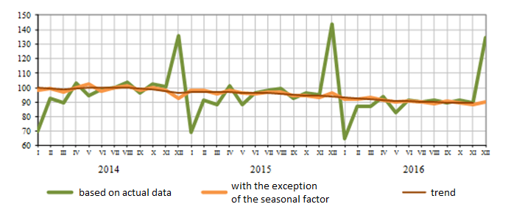
REAL DISPOSABLE HOUSEHOLD INCOME (%, as compared to monthly average of 2013)

Slide 21
DYNAMICS OF GROSS VALUE ADDED BY ECONOMIC SECTORS, at market prices, 2016/2014
 | 2016/2014
Gross domestic product | 108%
including:
Agriculture, hunting and forestry | 121%
Fishing, fish farming | 165%
Mineral extraction | 119%
Manufacturing | 112%
Production and distribution of electricity, gas and water | 122%
Construction | 105%
Wholesale and retail trade; repair of vehicles and motorcycles, household goods and personal items | 101%
Hotels and restaurants | 116%
Transport and communications | 123%
Financial activities | 110%
Real estate operations, rent and delivery of services | 114%
Public administration and military security; social insurance | 111%
Education | 107%
Health and social services | 110%
Other utility, social and personal services | 121%
Activities of households | 116%

Slide 22
PANDEMIC IS NOT A REASON TO LIFT SANCTIONS
The topic about lifting the sanctions started increasingly appearing as soon as sanctions were considered as prevention from fighting the pandemic together. Michelle Bachelet, the UN High Commissioner for Human Rights. “No country can effectively fight this epidemic on its own. We need to act on the basis of solidarity, cooperation and care”
At the end of March, Russian President Vladimir Putin at the G20 summit, which was dedicated to the fight against the pandemic, called on colleagues to create "green corridors free from trade wars and sanctions for the mutual supply of medicines, food, equipment and technology.“
The EU, USA, UK, Ukraine and Georgia have blocked the Russian draft resolution on global solidarity in the fight against coronavirus disease, which proposed to abandon the use of unilateral sanctions.
Moreover, at the peak of the coronavirus crisis, in the context of the wars in the oil market, Washington started to declare about new sanctions as a tool for forcing Moscow and Riyadh to urgently reduce production.
Updating of sanctions lists continued in 2020.

Slide 23
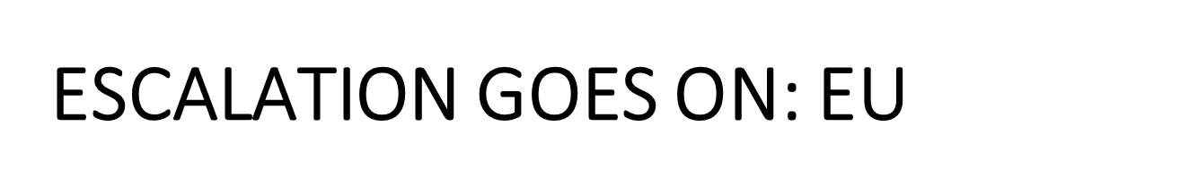
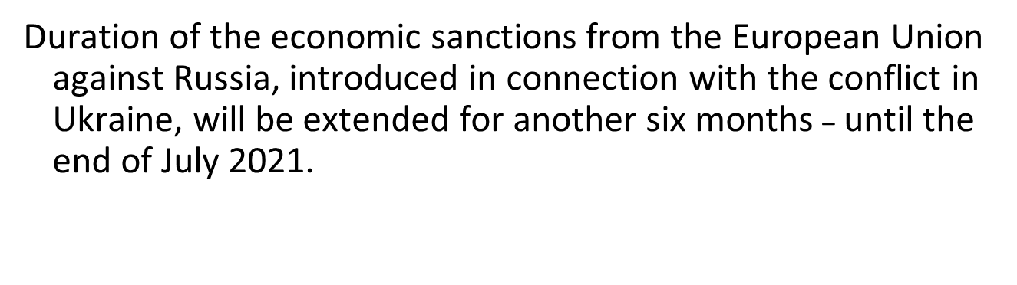
ESCALATION GOES ON: USA
The US Bureau of Industry and Security has sanctioned five Russian research institutes, including the Research Institutes, which took part in the development of a vaccine against coronavirus infection. It means that restrictions on the export, re-export and transfer of goods are imposed on these organisations.

Slide 24
HOW DID THE SANCTIONS AFFECT THE RUSSIAN ECONOMY?
On the one hand, any restrictions on the capital flow have negative implications for the economy. On the other hand, Russia has been in this situation for a long time and it almost coped with it prior to the viral shock. Thus, foreign investments in Russian stocks and bonds (especially federal loan obligations, OFZ) were more correlated with oil prices and the ruble exchange rate than with the sanctions regime.
In general, the net investment position of Russia as a state has significantly improved both in comparison with 2014 and especially with 2008, when the effect of the global crisis turned out to be the hardest for the Russian economy.
The Russian economy was able to replace external sources of financing with internal ones and is now less dependent on large-scale capital outflows from emerging markets.

Slide 25
EXTERNAL ACCOUNT OF RUSSIA PRIOR TO THE LAST THREE CRISES
 | 2008 | 2014 | 2020
Gold and foreign exchange reserves, $ billion | 596 | 484 | 551
Russian National Wealth Fund and Reserve Fund, $ billion | 163 | 174 | 123.4
Average annual prices for Brent oil, $ (in rubles, 2008) | 98 (2350) | 107 (2430) | 60 (1800)
Net investment position, $ billion | -148.6 | 131.7 | 356.5
External debt, $ billion | 533.4 | 715.9 | 495.3
Including:
State and Central Bank | 38 | 69 | 84
Banks | 193 | 214 | 78
Corporate sector | 303 | 433 | 333

Slide 26
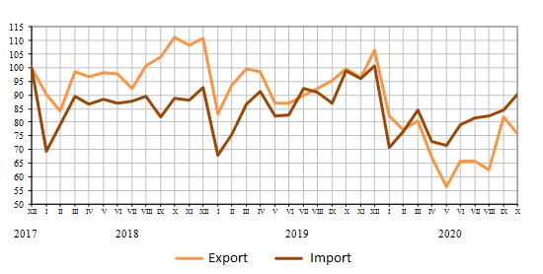
DYNAMICS OF RUSSIAN EXPORT AND IMPORT (%, as compared to December, 2017)

Slide 27
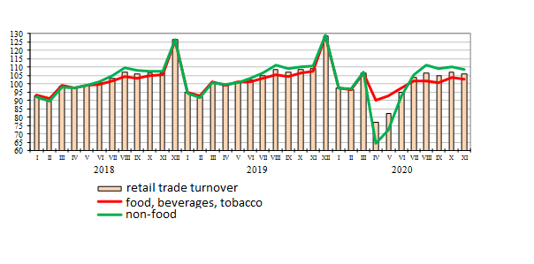
DYNAMICS OF RETAIL TRADE TURNOVER, INCLUDING FOOD, BEVERAGES, TOBACCO AND NON-FOOD (%, as compared to monthly average of 2017)

Slide 28
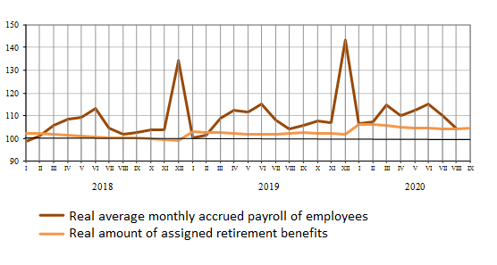
DYNAMICS OF REAL WAGES AND RETIREMENT BENEFITS
(%, as compared to monthly average of 2017)

Slide 29
CORONAVIRUS CRISIS: SPATIAL PROJECTION
The most affected areas: typical cases of financial and economic crises: regions with a low level of economic development, weak foreign economic relations, and a low level of migration growth.
The most affected areas: coronacrisis crisIs:
The largest urban agglomerations (Moscow, St. Petersburg, cities with a population of more than a million people).
Oil and gas production centers with a high concentration of migrants living in isolated settlements (regions of the North and Far East, Khanty-Mansiysk, Yamalo-Nenets Autonomous Okrugs).
Regions where, due to the specifics of cultural and religious traditions, it is difficult for people to abandon active social communication (Dagestan, Ingushetia)

Slide 30
WILL THE SANCTIONS HINDER THE RECOVERY OF THE RUSSIAN ECONOMY IN POST-PANDEMIC TIME?
During a period of overcoming the crisis, the sanctions-caused isolation of Russia will restrain recovery of the economy, as in 2015-2019.
A more significant deterrent to growth was not the external sanctions imposed by the Western world, but the ultra-tough policy of "macroeconomic stabilisation" at the expense of economic stagnation.
The Central Bank of the Russian Federation may follow the example of the rest of the world's central banks and stimulate economic growth even at the cost of inflation above 5-6%. In this case no external sanctions will restrain foreign investors from looking for profitable opportunities in the Russian economy.

Slide 31
THE WORLD AFTER THE PANDEMIC
Predictions for a post-coronavirus future are not very optimistic so far. A post-pandemic world will be characterised with the economy of "simple things", protectionism, attempts to return factories from China, (Yakov Mirkin, the head of the International Capital Markets Department of the Institute of World Economy and International Relations of the Russian Academy of Sciences).
Former US Secretary of State Henry Kissinger also warns that the world will never be the same after the pandemic. He anticipates a rise in isolationism, "a resurgence of the concept of a walled city in an age when prosperity depends on global trade and movement of people.“
The confrontation between Washington and Beijing, which has been growing in recent years, can now obtain new traits. American lawmakers are calling for new restrictions on the export of American technology, as well as on supplies from China
Western countries are thinking about self-sufficiency in basic goods and about development of more reliable supply chains. Obviously, in the next couple of years all countries will have to primarily focus on solving domestic problems.

Slide 32
Irina Turgel, professor,
Ural Federal University, i.d.turgel@urfu.ru
Thank you for attention

Slide 33
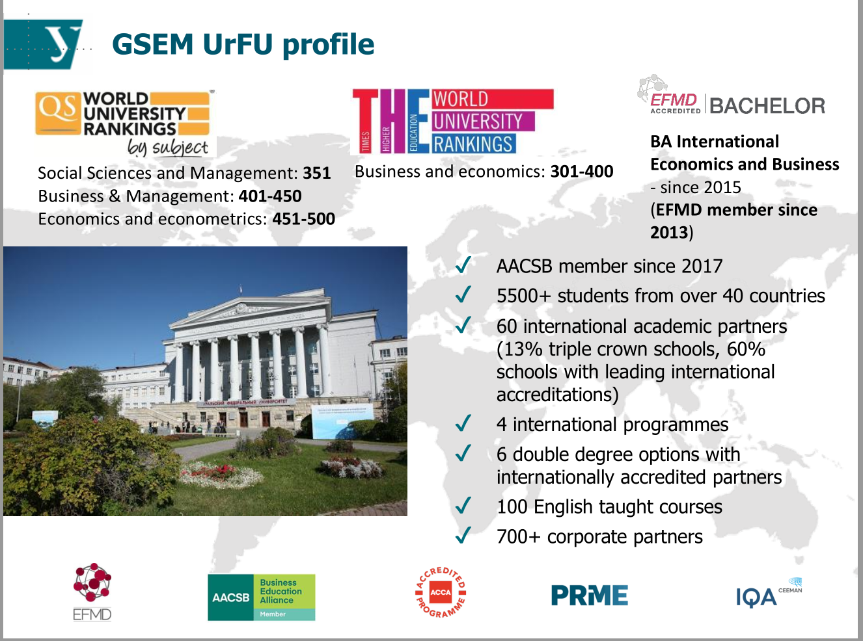

Slide 34
PRINCIPLES FOR APPLICATION OF SANCTIONS
the rule of law over all other arguments.
targeting of sanctions with the establishment of:
- a fair assessment of the circumstances,
- the contexts and reasons for the conflict of interests of the direct parties,
- guilt of the delinquent and assessment of the prerequisites and consequences of its actions, real damage to the parties of the conflict,
reliability of information, broad coverage of all the most significant aspects of the problem.
3) setting limits to application (extent of punishment, terms of its application, possible destructive consequences).
4) a ban on use as a means of gaining.
Sanctions should not turn into business. The party imposing the sanctions is not to become the beneficiary.
5) sanctions should not turn into a stream of public insults and humiliations against the delinquent state.

Slide 35
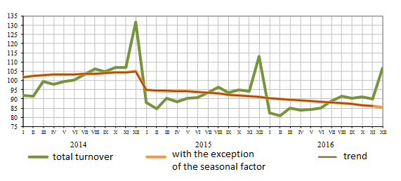
DYNAMICS OF RETAIL TRADE TURNOVER (%, as compared to monthly average of 2013)

Slide 36
CORONAVIRUS CRISIS: IS POLITICAL WARMING POSSIBLE?
In April the United States purchased from Russia ventilators manufactured by Concern Radio-Electronic Technologies (KRET), which has been under the US sanctions since 2014. The supplies were partially paid by Russia’s sovereign wealth fund (RDIF), to which the US Department of the Treasury, prohibited loans.
The European Bank for Reconstruction and Development (EBRD) unexpectedly made the first in six years Russian investment. The bank has approved up to $1 million in funding for online travel agency Travelata under its emergency coronavirus support.
The struggle for rescuing the oil market united the interests of Washington, Moscow and Riyadh. The leaders of Russia and the United States spoke on the phone several times a day during the second week of April to finalise the agreement on the largest downwards in overall crude oil production in history.
Cuban doctors, arrived on emergency missions in 14 countries, including Italy, to help local doctors, media reported.
Russian military doctors are helping to fight the virus in Lombardia.

Slide 37
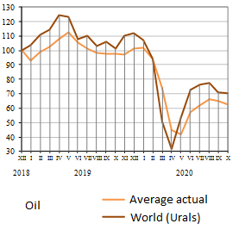
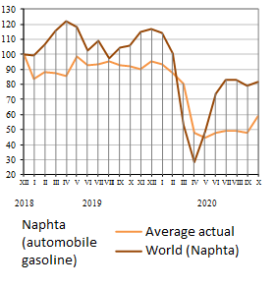
DYNAMICS OF AVERAGE ACTUAL PRICES FOR RUSSIAN EXPORTS AND WORLD PRICES FOR SELECTED GOODS (%, as compared to December 2018)

Slide 38
MAIN SOCIO-ECONOMIC INDICATORS, %

Slide 39
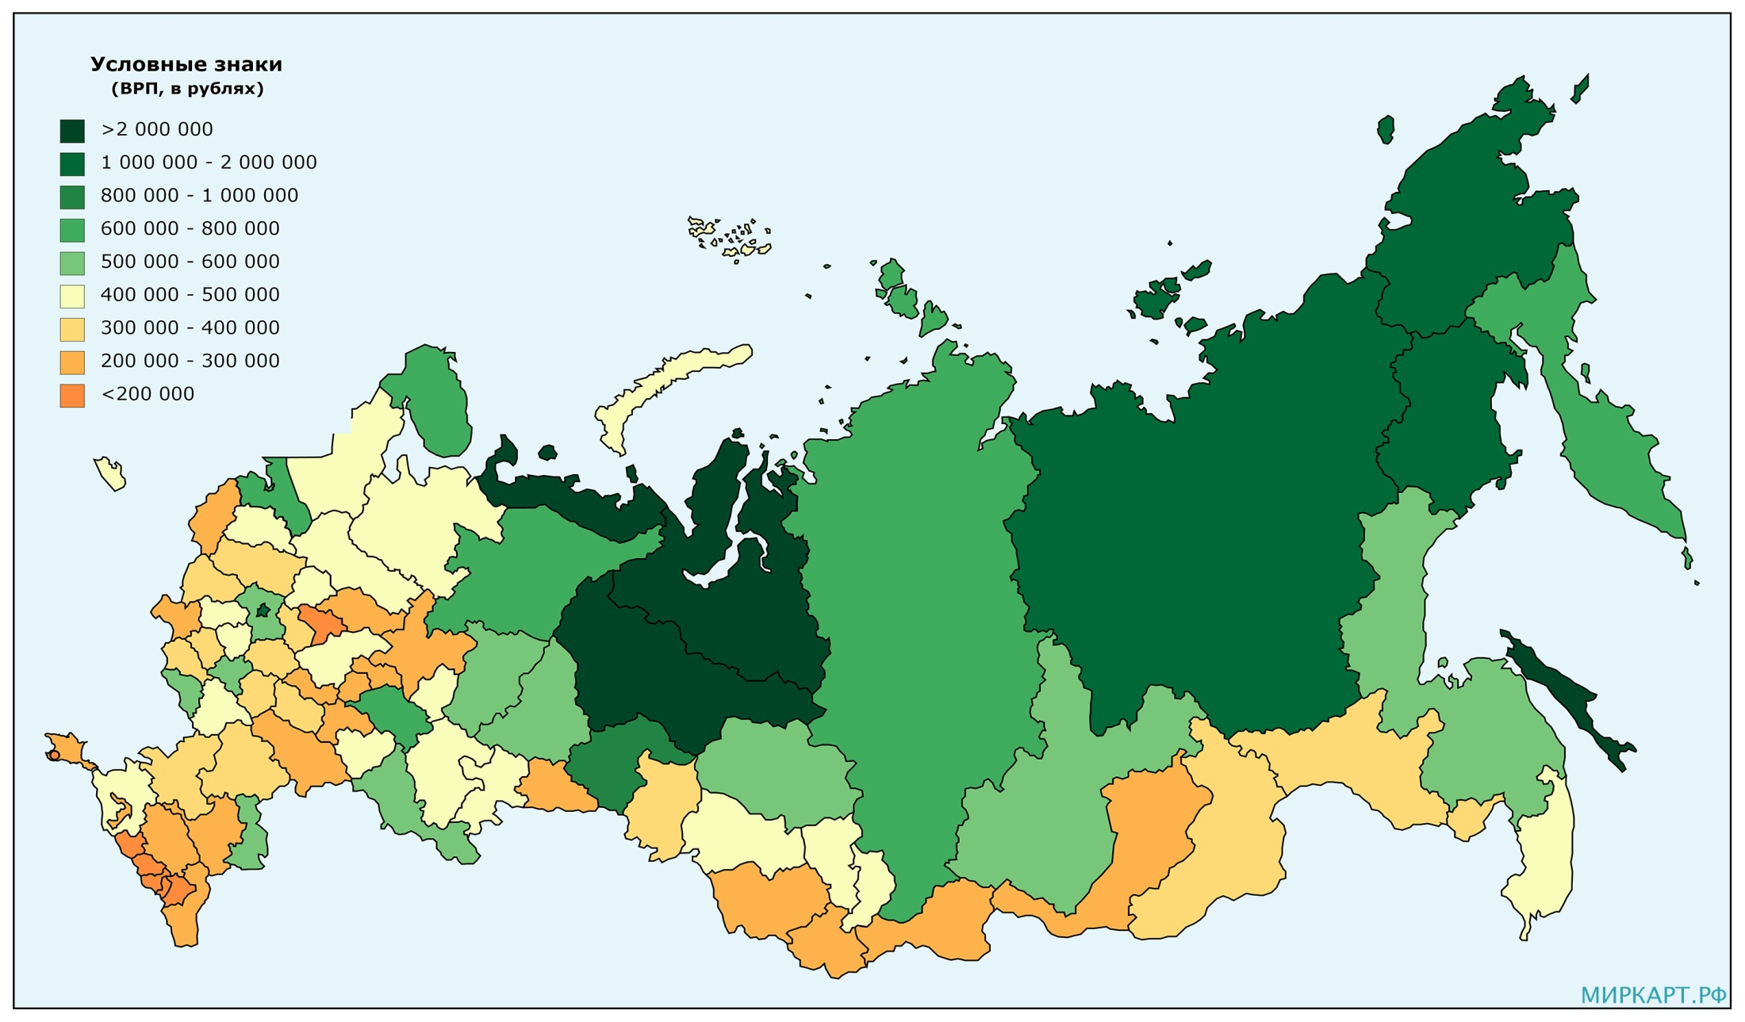
GROSS REGIONAL PRODUCT PER CAPITA OF POPULATION, 2018, RUBLES

Slide 40
LEVELS OF INTERNATIONAL SANCTIONS
1) global level, where sanctions are imposed by international organisations such as UN, IMF, G7, etc.;
2) interstate level at which international sanctions are applied by individual states or associations of allied states;
3) sectoral level – the level of individual state institutions or sectors of the economy involved in interstate cooperation;
4) corporate level, including transnational, state and private companies and corporations engaged in foreign trade activities;
5) individual level – the level of individual citizens, decision-makers, prominent politicians, public figures or persons suspected of committing crimes.

